Slide 1

International Commission on
Occupational Health

Slide 2
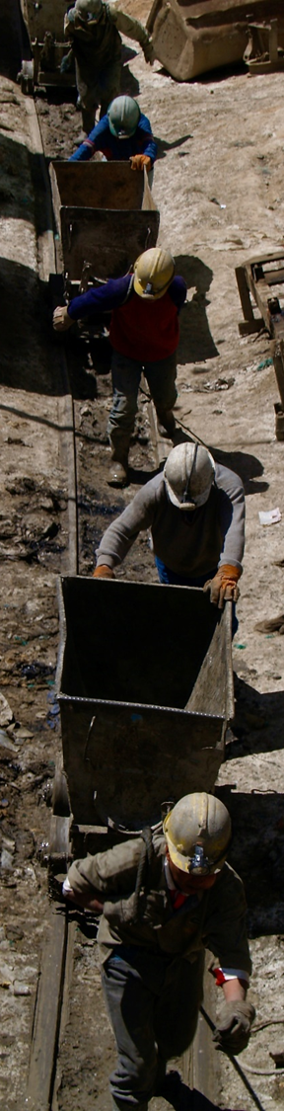
About ICOH
The International Commission on Occupational Health (ICOH) is an international non-profitmaking, non-political, multidisciplinary scientific organisation whose sole purpose is to foster the scientific progress, knowledge and development of occupational health and related subjects on an international basis.
(Constitution, Article 1, Section 1)

Slide 3
About ICOH
ICOH provides a forum for scientific and professional communication. To achieve this purpose, the ICOH:
sponsors international congresses and meetings on occupational health;
establishes scientific committees in various fields of occupational health and related subjects;
disseminates information on occupational health activities;
issues guidelines and reports on occupational health and related subjects;
collaborates with appropriate international and national bodies on matters concerning occupational and environmental health;
takes any other appropriate action related to the field of occupational health;
solicits and administers such funds as may be required in furtherance of its objectives.
(Constitution, Article 1, Section 2)

Slide 4

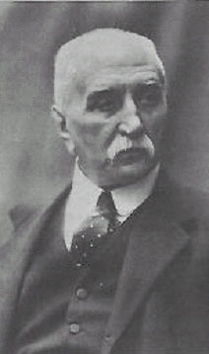

Milan, 1906
First International Congress on Occupational Health
Malachia De Cristoforis founder and first President of the International Permanent Commission for Occupational Health
Foundation of the International Permanent Commission for Occupational Health
1906 Congress proceedings

Slide 5
21st International Congress for Occupational Health - 1984 - Dublin
The Permanent Commission and International
Association on Occupational Health
becomes International Commission on
Occupational Health (ICOH)
New professional groups participate:
industrial medical officers,
occupational health specialists, etc.

Slide 6
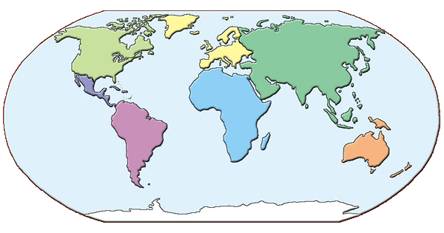
International Congresses on Occupational Health
2022
Melbourne - Rome
digital congress
2027
Mumbai
2009
Cape Town
2012 Cancun
2015
Seoul
2018 Dublin
2024 Marrakesh
2030
Rome
2006
Milan
1906 Milan
2003
Iguassu Falls
1910
Brussels
2000
Singapore
1925
Amsterdam
1996
Stockholm
1928
Budapest
1993
Nice
1931
Geneva
1990
Montreal
1935
Brussels
1987
Sydney
1938
Frankfurt
1984
Dublin
1948
London
1981
Cairo
1951
Lisbon
1954
Naples
1978
Dubrovnik
1957
Helsinki
1975
Brighton
1972
Buenos Aires
1969
Tokyo
1966
Vienna
1963
Madrid
1960
New York

Slide 7
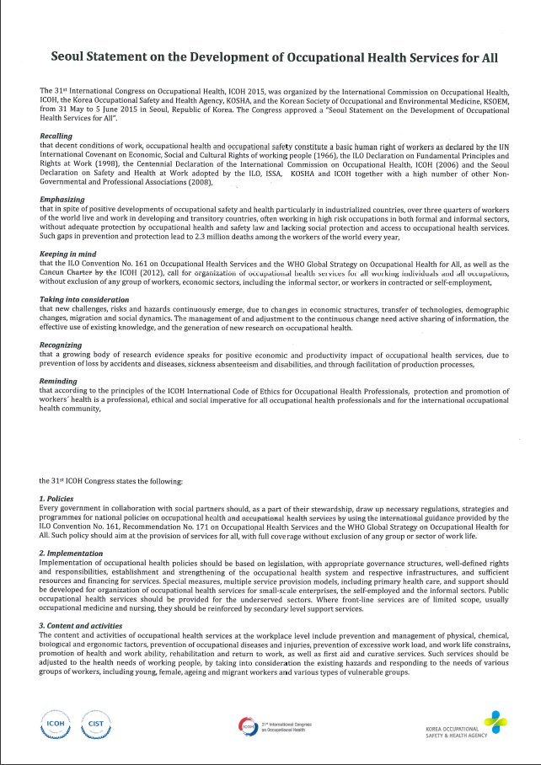
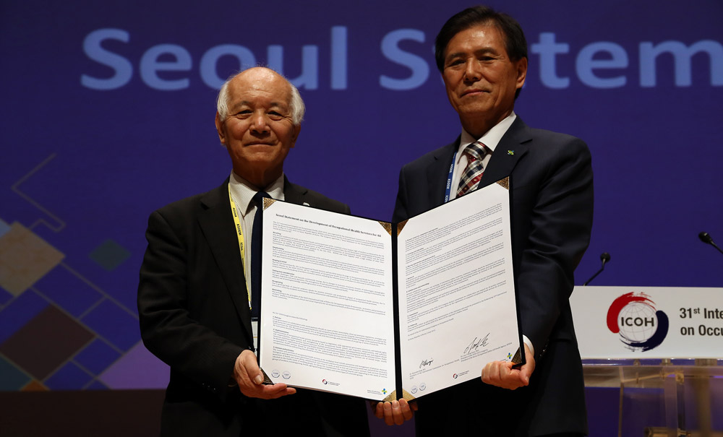
Congress Statements
Seoul Statement on the Development of Occupational Health Services for All
…the signing at ICOH2015

Slide 8
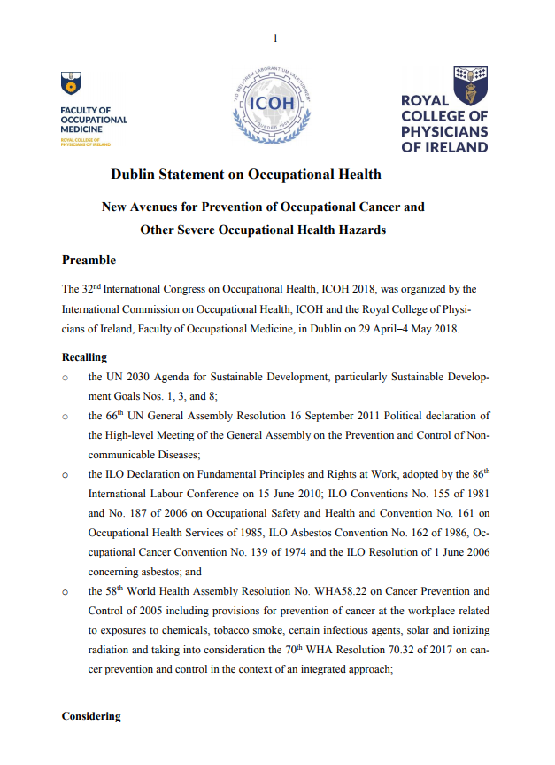
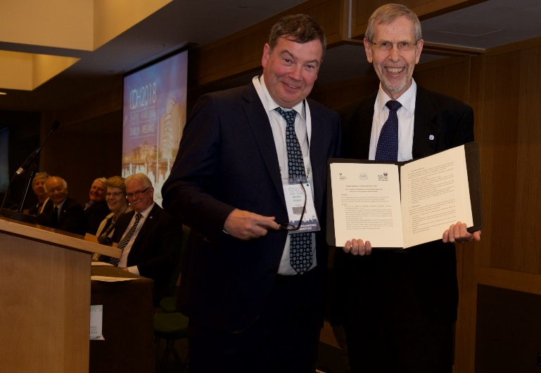
Congress Statements
Dublin Statement on Occupational Health
…the signing at ICOH2018

Slide 9

ICOH Statement on protecting Occupational Safety and Health of Migrant Workers
The statement is the result of a joint effort by:
ICOH Working Group on Future of Decent Work
ICOH SC on Thermal Factors
ICOH SC on Occupational Health in Small-Scale Enterprises and the Informal Sector
ICOH Officers
ICOH Board Members
Available at :
https://www.icohweb.org/site/multimedia/news/pdf/Occupational%20health%20of%20migrant%20workers.pdf
Safety and Health at Work (2022), 13:261-2.

Slide 10
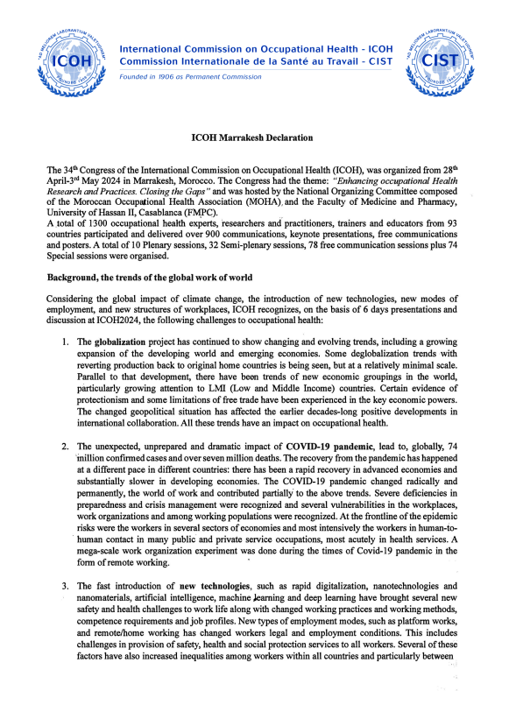
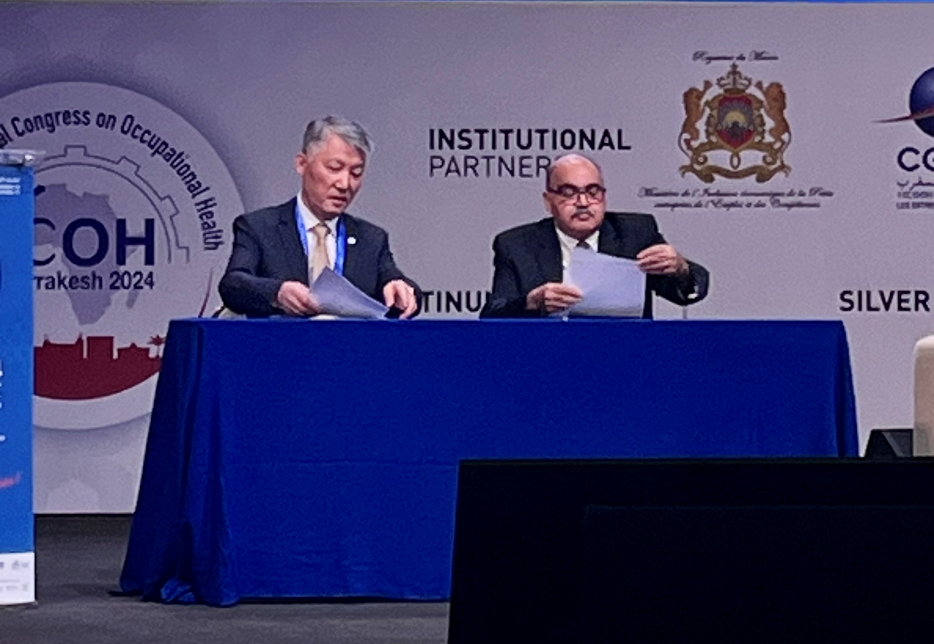
ICOH Marrakesh Declaration on Occupational Health
34th International Congress on Occupational Health
…the signing at ICOH2024
Available at:
https://www.icohweb.org/site/multimedia/news/pdf/Marrakesh%20Declaration%20signed.pdf
Safety and Health at Work (SH@W), 15 (2):242, 2024

Slide 11

ICOH 2027
35th International Congress on Occupational Health
Mumbai, India
14 – 19 Feb 2027
icoh2027.in

Slide 12






ICOH Governmental Partners
World Health Organization
International Labour Organization
ICOH Non Governmental Partners
International Ergonomics Association
International Social Security Association
International Occupational Hygiene Association
International Association Labour Inspection

Slide 13
Members in good standing
Membeship type | 2002* | 2005* | 2008* | 2011* | 2014* | 2017* | 2021* | 2023*
Active (A) | 1,486 | 1,536 | 1,615 | 1,565 | 1,703 | 1,676 | 1,792 | 1,496
Retired (R) | 22 | 18 | 6 | 12 | 14 | 20 | 28 | 29
Honorary (H) | 26 | 15 | 19 | 25 | 26 | 25 | 25 | 27
Emeritus (E) | 110 | 119 | 103 | 145 | 143 | 218 | 219 | 223
Affiliate (AFF) | 27 | 21 | 21 | 19 | 17 | 17 | 25 | 19
Sustaining (SUS) | 17 | 18 | 16 | 17 | 18 | 20 | 18 | 13
Total | 1,688 | 1,727 | 1,780 | 1,783 | 1,921 | 1,976 | 2,107 | 1,807
*Data refer to the end of each triennium

Slide 14
Membership Campaign
Geographical distribution

Slide 15
Membership Campaign
Members per country
COUNTRY | MEMBERS | COUNTRY | MEMBERS
1. India | 217 | 7. South Africa | 54
2. Morocco | 105 | 8. P.R. China | 48
3. USA | 101 | 9. Australia Finland | 43
4. Italy | 90 | 10. Peru | 42
5. Japan | 74 | 11. Kenya | 41
6. Brazil | 66 | 12. Indonesia | 40
Last update 31 Dec 2023

Slide 16
Membership Campaign
GPD per capita
31 Dec 2023
High income countries
33%
Low income countries
39%
Middle income countries
28%
LMICs represent 2/3 of the total ICOH membership

Slide 17
Individual Member Profile
Profession
Average age
51
Gender distribution
Last update 31 Dec 2023

Slide 18














ICOH Sustaining Members

Slide 19




















ICOH Affiliate Members

Slide 20
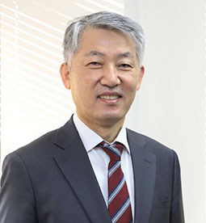
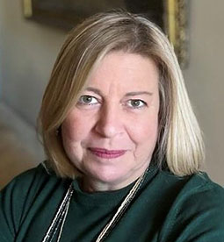

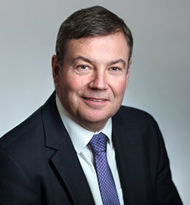
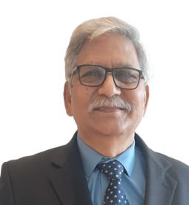
President
Seong-Kyu Kang
Republic of Korea
Secretary General
Diana Gagliardi
Italy
ICOH Officers
Vice-President
Martin Hogan
Ireland
Vice-President
Shyam Pingle
India

Slide 21














ICOH Board
Alexis Descatha
Mahinda
Seneviratne
Rosylane Rocha
Quentin
Durand - Moreau
Dongmug
Kang
Riitta
Sauni
Stefan
Esser
Rim
El Kholti
Aida Lucia
Fajardo Montiel
Ashish
Mishra
Naesinee
Chaiear
Charles Milton
Yarborough
R. Rajesh
Akizumi
Tsutsumi
Giovanna Spatari
Kamal Wifaq

Slide 22
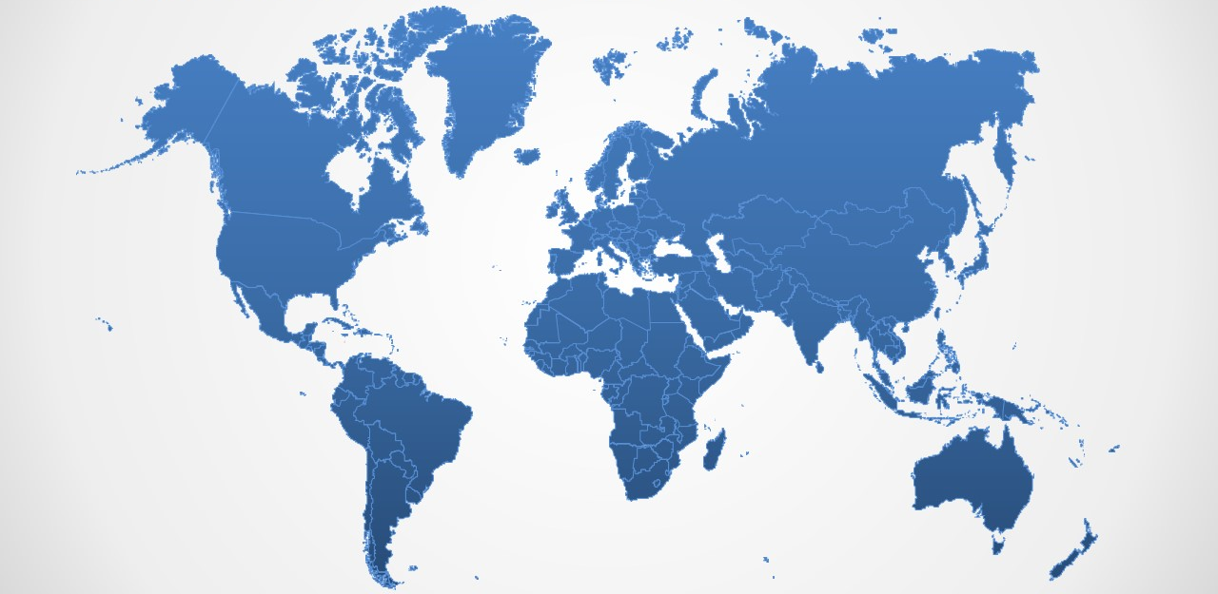





ICOH National/Area Secretaries Worldwide
2024

Slide 23

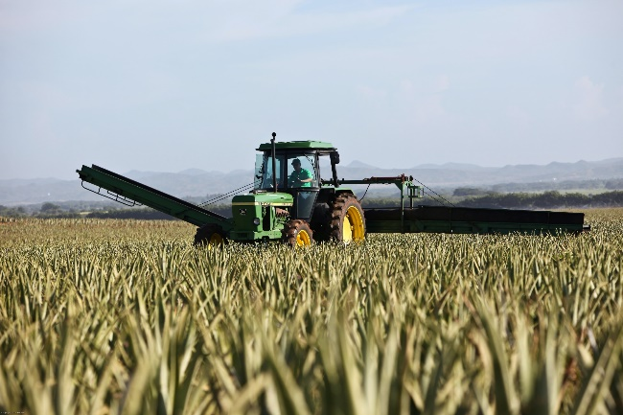




ICOH Accomplishments
ICOH activities cover a wide range of topics, as reflected by the 38 Scientific Committees, each one focused on a specific area.

Slide 24
Scientific Committees
Accident Prevention
Effectiveness in Occupational Health Services
Emergency Preparedness and Response in Occupational Health
Epidemiology in Occupational Health
Allergy and Immunotoxicology
Cardiology in Occupational Health
Education and Training in Occupational Health
Aging and Work
Biohazards and Occupational Health

Slide 25
Scientific Committees
History of Prevention of Occupational and Environmental Diseases
Indoor Air Quality and Health
Nanomaterial Workers’ Health
Neurotoxicology and Psychophysiology
Occupational and Environmental Dermatoses
Occupational Health and Development
Industrial Hygiene
Mining Occupational Safety and Health
Musculoskeletal Disorders

Slide 26
Scientific Committees
Occupational Health for Health Workers
Occupational Health in Small-Scale Enterprises and the Informal Sector
Occupational Medicine
Occupational Toxicology
Radiation and Work
Reproductive Hazards in the Workplace
Occupational Health in the Chemical Industry
Occupational Health in the Construction Industry
Occupational Health Nursing

Slide 27
Scientific Committees
Respiratory Disorders
Rural Health: Agriculture, Pesticides and Organic Dusts
Unemployment, Job Insecurity and Health
Vibration and Noise
Women Health and Work
Work and Vision
Shiftwork and Working Time
Thermal Factors
Toxicology of Metals
Work Disability Prevention and Integration
Work Organization and Psychosocial Factors

Slide 28



ICOH CORE DOCUMENTS

Slide 29

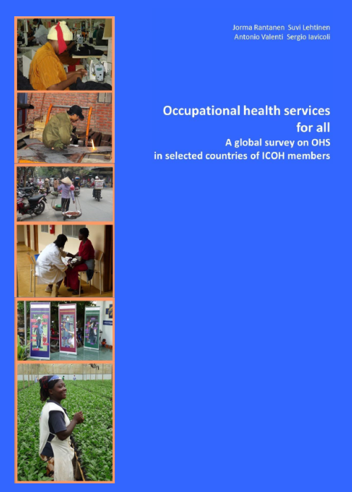
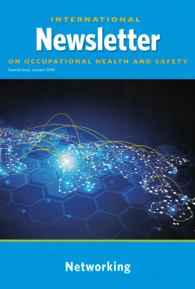
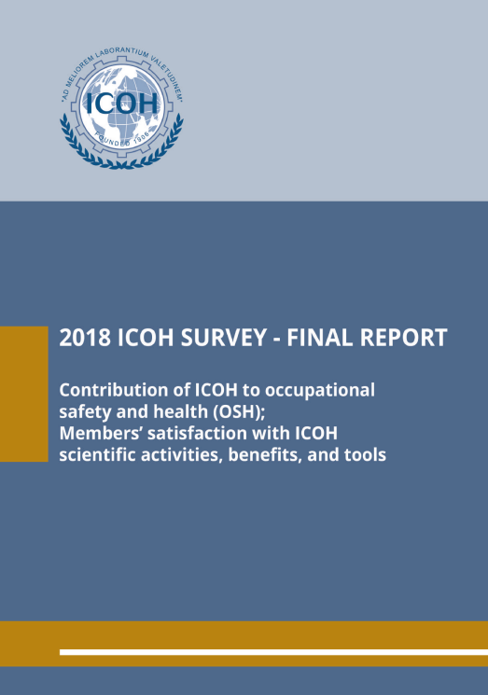
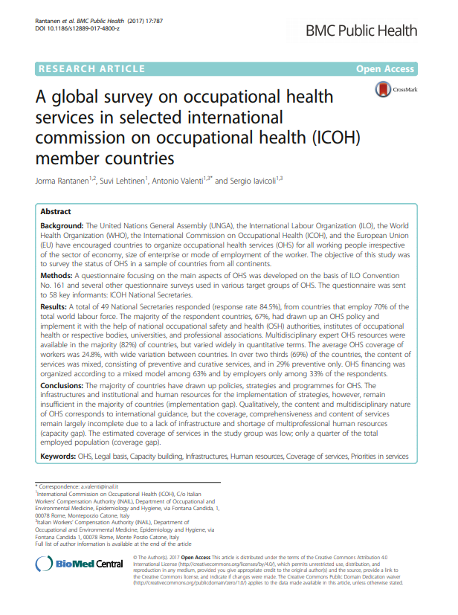

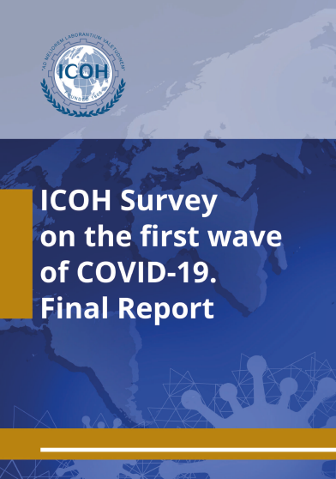
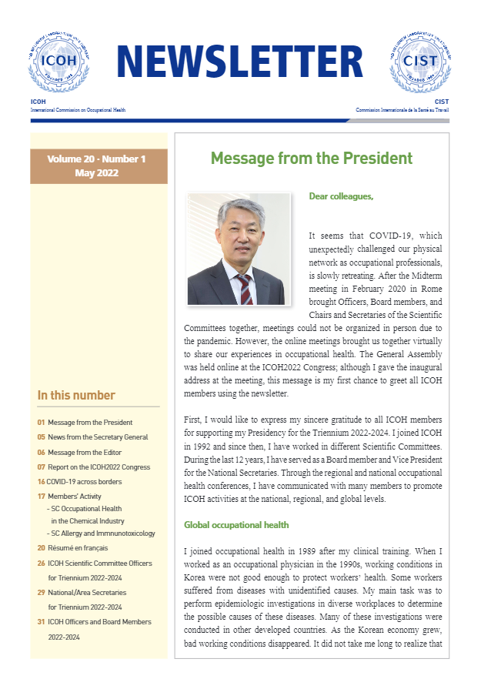
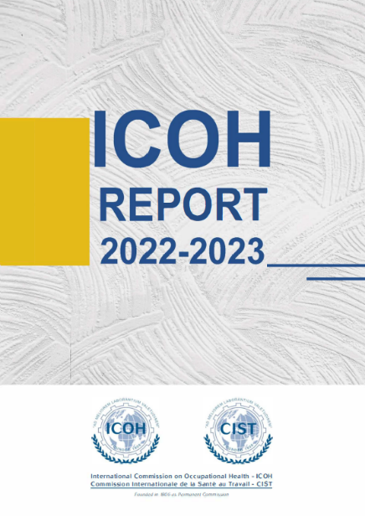
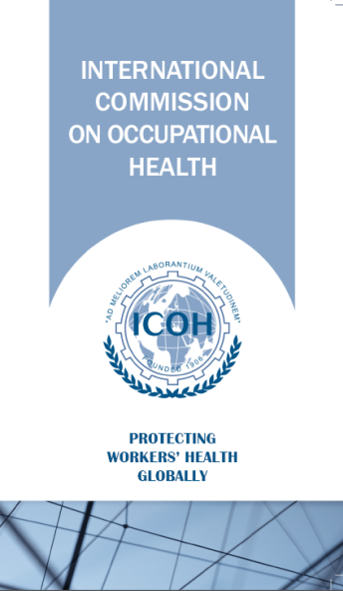
ICOH Outputs

Slide 30
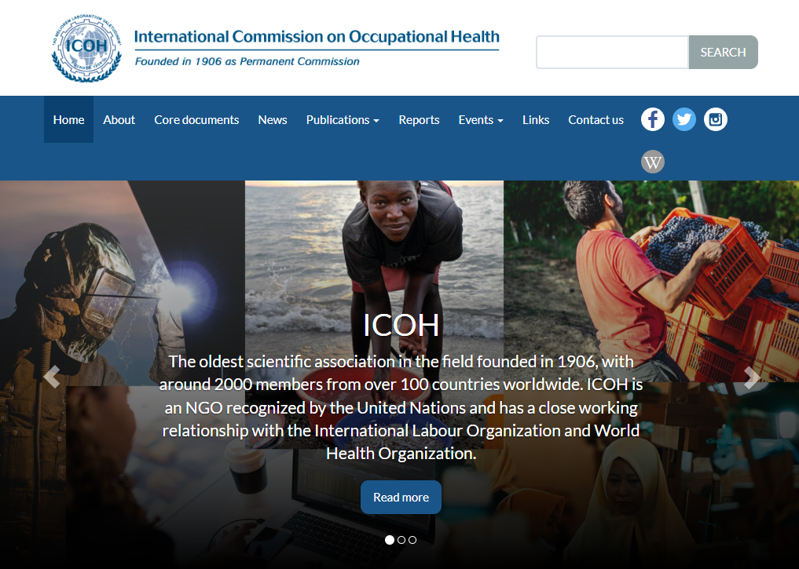
ICOH website
www.icohweb.org

Slide 31



ICOH on Social Media
ICOH_org
1529 followers (+659 since ICOH2022)
ICOH_org
1286 followers (+784 since ICOH2022)
Icoh Cist
1868 followers (+577 since ICOH2022)

Slide 32



ICOH on Social Media
Using simple, clear and standardized layouts, since the summer of 2022 we have advertised and promoted the events organised by ICOH Scientific Committees (39) and we have shared ICOH statements of different subjects (4)
9
On-site events
3
Hybrid events
4
Statements/Letters
1
Virtual Congress
26
Webinars

Slide 33
Benefits and tools for members
Website and Private Area
ICOH Publications
Newsletter and communication tools
Noro fund
Grant for congress attendees from low and middle income countries
ILO Master Fellowship
Student Awards
Journal discounts
Free ICOH webinars

Slide 34
INDIVIDUAL MEMBERSHIP FEES 2024-2027
COUNTRIES WITH | GDP<5,000 USD | 5,000<GDP<15,000 USD | GDP>15,000 USD
ACTIVE MEMBERS | 45.00 CHF | 72.00 CHF | 345.00 CHF
YOUNG <34 | 30.00 CHF | 45.00 CHF | 72.00 CHF
RETIRED | 30.00 CHF | 60.00 CHF | 90.00 CHF
Applications can be submitted through the ICOH website
www.icohweb.org

Slide 35
SUSTAINING MEMBERS FEES 2024-2027
LOW INCOME COUNTRIES GDP < 5,000 | 800 CHF
MEDIUM INCOME COUNTRIES 5,000 < GDP < 15,000 | 2,500 CHF
HIGH INCOME COUNTRIES GDP > 15,000 | 5,000 CHF
AFFILIATE MEMBERS FEES 2024-2027
>200 MEMBERS | 660 CHF
<200 MEMBERS | 440 CHF

